Slide 1
Read to Achieve
April 2023

Slide 2
Excellent Public Schools Act
The Excellent Public Schools Act became law in July 2012 and was implemented in 2013-2014.
During the summer of 2021, Senate Bill 387 was written to align literacy instruction with the Science of Reading and to modify the implementation of the NC Read to Achieve Program in order to attain statewide reading proficiency by the third grade.
The legislation is titled: Excellent Public Schools Act 2021

Slide 3
Read to Achieve Legislation Key Points
K-3rd grade students shall be assessed with valid, reliable, formative and diagnostic reading assessments (DIBELS).
The reading assessment data will be used to identify root causes for difficulty with reading development and determine actions to address them.
Parents will be notified if their child is not reading at grade level and possible retention or exemption for good cause. (Good cause exemption will be covered shortly.)
Parents will be notified of retention and the reason their child is not eligible for a good cause exemption.
Parents will be notified of a description or plan for reading interventions and supports.

Slide 4
Third Grade Benchmarks
DIBELS-BOY, MOY, EOY
BOG-Sept. 2022
EOG Reading-May 2023
EOG Retest- June 2023
Read to Achieve test-June 2023
**Some students will be exempt from taking the EOG retest and Read to Achieve text based on a good cause exemption. If this affects your child, you will be notified within the next few weeks.

Slide 5
Summer Reading Camp
If a student does not show proficiency through multiple pathways offered by the end of third grade, they will be invited to participate in Summer reading camp.
Designed to provide additional instruction in 2nd and 3rd grade reading
Free - no cost to parents
Not mandatory, but strongly encouraged.
June 26th-July 27th, off week of July 4th
Site based on home school
Read to Achieve Test given at the end of summer camp

Slide 6
Retention
A student that did not meet RTA benchmarks or exemptions will be placed in one of three classes based on their needs and the capacity of the school. Placement must be decided by the principal and teachers most familiar with each child and signed off by Learning Community Superintendent and Superintendent.
Retained in 3rd Grade
(must have a reading retained label in Powerschool by August 2023)
3rd grade standards and curriculum
3rd grade EOG
3rd/4th Transitional Class with Reading Retained Label in Powerschool by August 2023
4th grade standards and curriculum
4th grade EOG
4th Grade Accelerated Reading Class with Reading Retained Label in Powerschool by August 2023
4th grade standards and curriculum
4th grade EOG
2 year growth in 1 year

Slide 7
What Can Parents Do at Home?
Read to your child every day.
Take children's books and writing materials with you whenever you leave
home.
Create a quiet, special place in your home for your child to read, write and
draw.
Help your child see that reading is important. Set a good example for your
child by reading books, newspapers and magazines.
Limit the amount and type of television you and your child watch.
Contact your child’s teacher for specific strategies that will support your child
in their reading development.

Slide 8
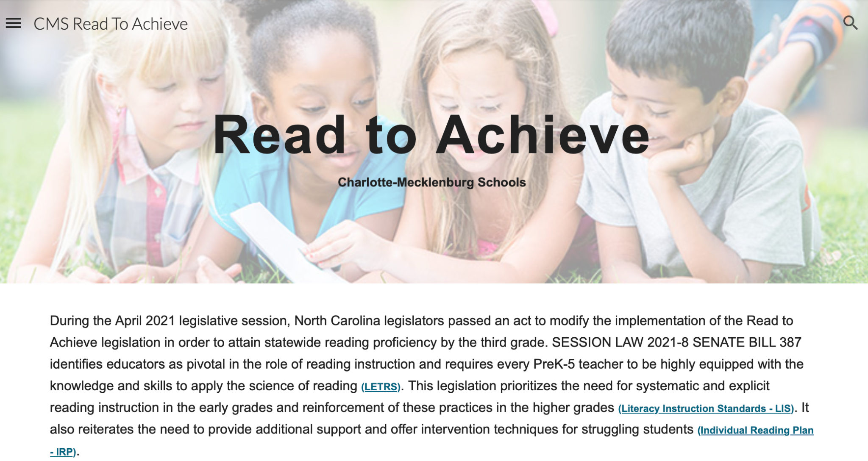
CMS RTA Website
Additional information about the RTA legislation and resources are located on the CMS RTA Website.
https://sites.google.com/cms.k12.nc.us/cmsreadtoachieve/home?authuser=0

